Slide 1









My Algebra – Polynomials Interactive Notebook
$$×$$
$$\frac{1}{2}$$
$$÷$$
$$+$$
$$−$$
$$\frac{3}{5}$$
$$7$$
Name
Class
Teacher
Term 2 Semester 1
$$5^{2}$$
$$\sqrt{9}$$

Slide 2
Contents
Glossary or Formula Page
Page
Date
Description
2

Slide 3
Tasks
24
7
30
Essential Question
Questions
Notes
Summary
6

Slide 4
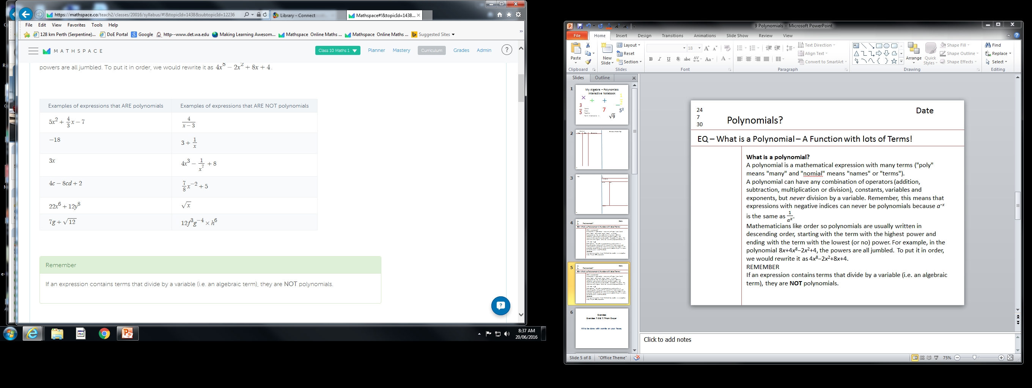
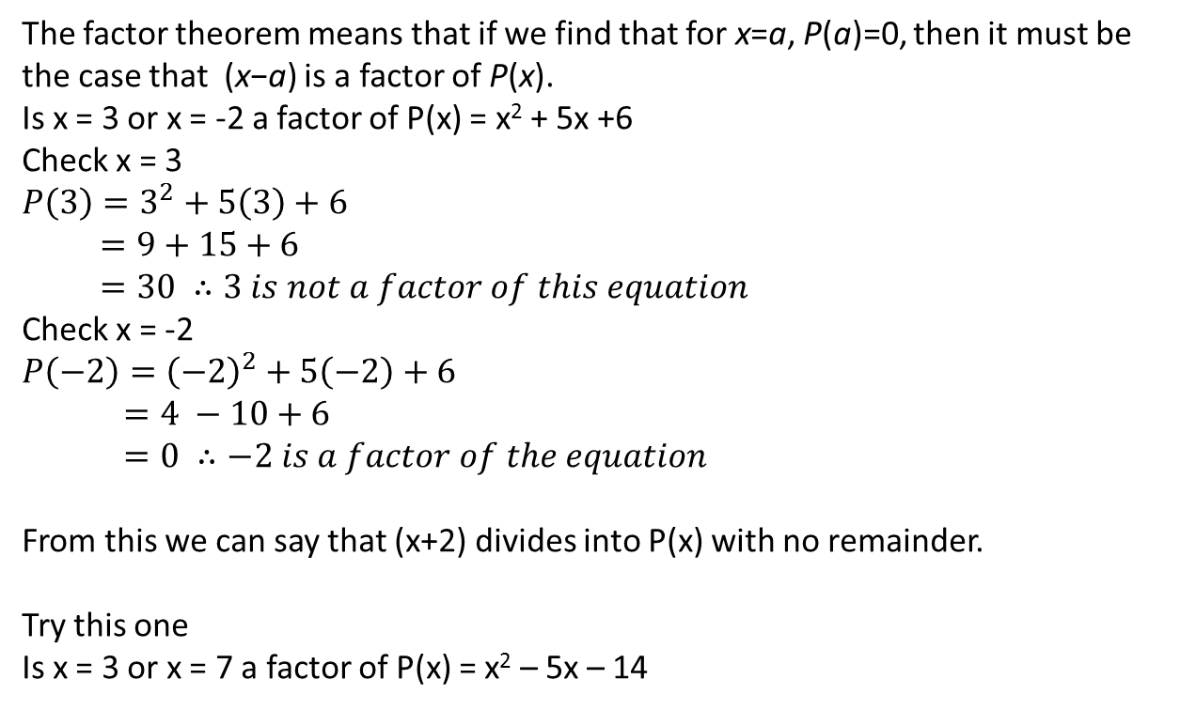
24
7
30
Date
Polynomials?
EQ – Factor Theorem!
The factor theorem means that if we find that for x=a, P(a)=0, then it must be the case that (x−a) is a factor of P(x).
Is x = 3 or x = -2 a factor of P(x) = x² + 5x +6
Check x = 3
$$P\left(3\right)=3^{2}+5\left(3\right)+6 \\ =9+15+6 \\ =30 ∴3 is not a factor of this equation$$
Check x = -2 $$P\left(−2\right)={\left(−2\right)}^{2}+5\left(−2\right)+6 \\ =4 −10+6 \\ =0 ∴−2 is a factor of the equation$$
From this we can say that (x+2) divides into P(x) with no remainder.
Try this one
Is x = 3 or x = 7 a factor of P(x) = x² – 5x – 14

Slide 5
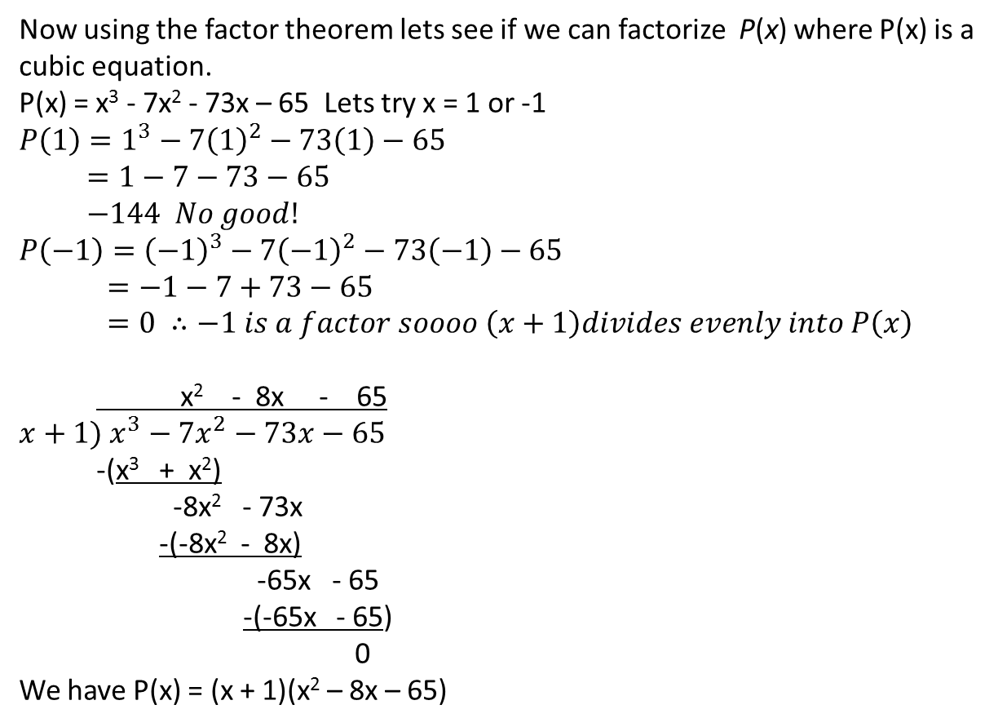
24
7
30
Date
Polynomials?
EQ – Factor Theorem – now Solving Polynomials!
Now using the factor theorem lets see if we can factorize P(x) where P(x) is a cubic equation.
P(x) = x³ - 7x² - 73x – 65 Lets try x = 1 or -1
$$P\left(1\right)=1^{3}−7{\left(1\right)}^{2}−73\left(1\right)−65 \\ =1−7−73−65 \\ −144 No good! \\ P\left(−1\right)={\left(−1\right)}^{3}−7{\left(−1\right)}^{2}−73\left(−1\right)−65 \\ =−1−7+73−65 \\ =0 ∴−1 is a factor soooo \left(x+1\right)divides evenly into P\left(x\right)$$
x² - 8x - 65
$$x+1) x^{3}−7x^{2}−73x−65$$ -(x³ + x²)
-8x² - 73x
-(-8x² - 8x)
-65x - 65
-(-65x - 65)
0
We have P(x) = (x + 1)(x² – 8x – 65)

Slide 6
24
7
30
Date
Polynomials?
EQ – Factor Theorem – now Solving Polynomials!
From previous page we have P(x) = (x + 1)(x² – 8x – 65)
Lets factorize the second part.
P(x) = (x + 1)(x² – 8x – 65)
P(x) = (x + 1)(x - 13)(x + 5)
Therefore the three solutions are x = -1, -5 or 13
This works quite easily with a cubic because you can easily factorize a quadratic. If we had a Quartic equation you would have to find two factors and divide in twice then factorize the quadratic equation.
Finding the factors is guess check and then improve.
2 Numbers that multiply to give -65 and have a difference of -8 -13 and 5

Slide 7
Exercises
Exercises 9.7 and 9.8 from Dwyer
All to be done with a smile on your faces.

Slide 8
Notes Review
24, 7 ,30
Date
Title
Essential question
Notes complete
Notes complete with colour and diagrams
Questions completed
Contents page filed in
Formula page filled in

Slide 9
Homework
Review your notes and write a summary answering the essential question.

